Slide 1
Convert Casual Cyclistic Riders to Annual Members: Case Study
Osama Bilgrami
February 2023
Notes:
Link to Case Study: https://d3c33hcgiwev3.cloudfront.net/aacF81H_TsWnBfNR_x7FIg_36299b28fa0c4a5aba836111daad12f1_DAC8-Case-Study-1.pdf?Expires=1676678400&Signature=Ivvf0r~BHgaaysgK~6zpoN~9ZMehC-lesen2f9G8zTCsTzDcqYX-qWFlG3nyRjcsrQ~TW6BOzseQXm5~EWDXoVUvy~4uHAiuc-cP5IuNlm2wLCfJkcW7S3ScSeHzsWHuGbX494e-xeJ67IC9EcV5HLAsUSnLbBuvZIg3zLo64dU_&Key-Pair-Id=APKAJLTNE6QMUY6HBC5A
Link to dataset: https://divvy-tripdata.s3.amazonaws.com/index.html (past 12 months data used)

Slide 2
About The Company
In 2016, Cyclistic launched a successful bike-share offering. Since then, the program has grown to a fleet of 5,824 bicycles that are geotracked and locked into a network of 692 stations across Chicago. The bikes can be unlocked from one station and returned to any other station in the system anytime.

Slide 3

Problem
Converting casual riders to annual members
Solution
Design a new marketing strategy to convert casual riders into annual members

Slide 4
Goals
Determine HOW annual riders and casual riders use Cyclistic bikes differently
Analyze and RECOMMEND 3 solutions based on the analysis

Slide 5
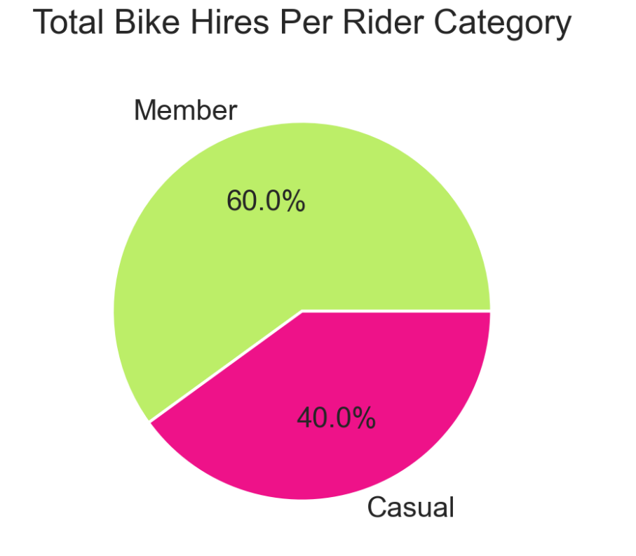
Too Casual
Casual riders make up 40% of our total bike riders.

Slide 6
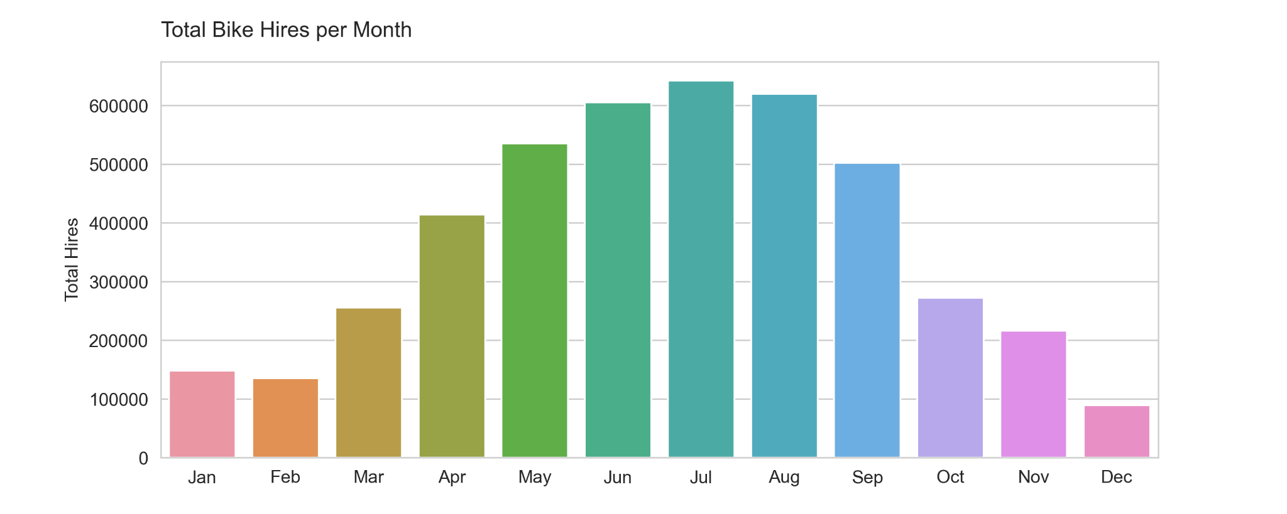
Pedalling Into Summer
Bike hires were highest in summer months
and lowest in the winter months

Slide 7
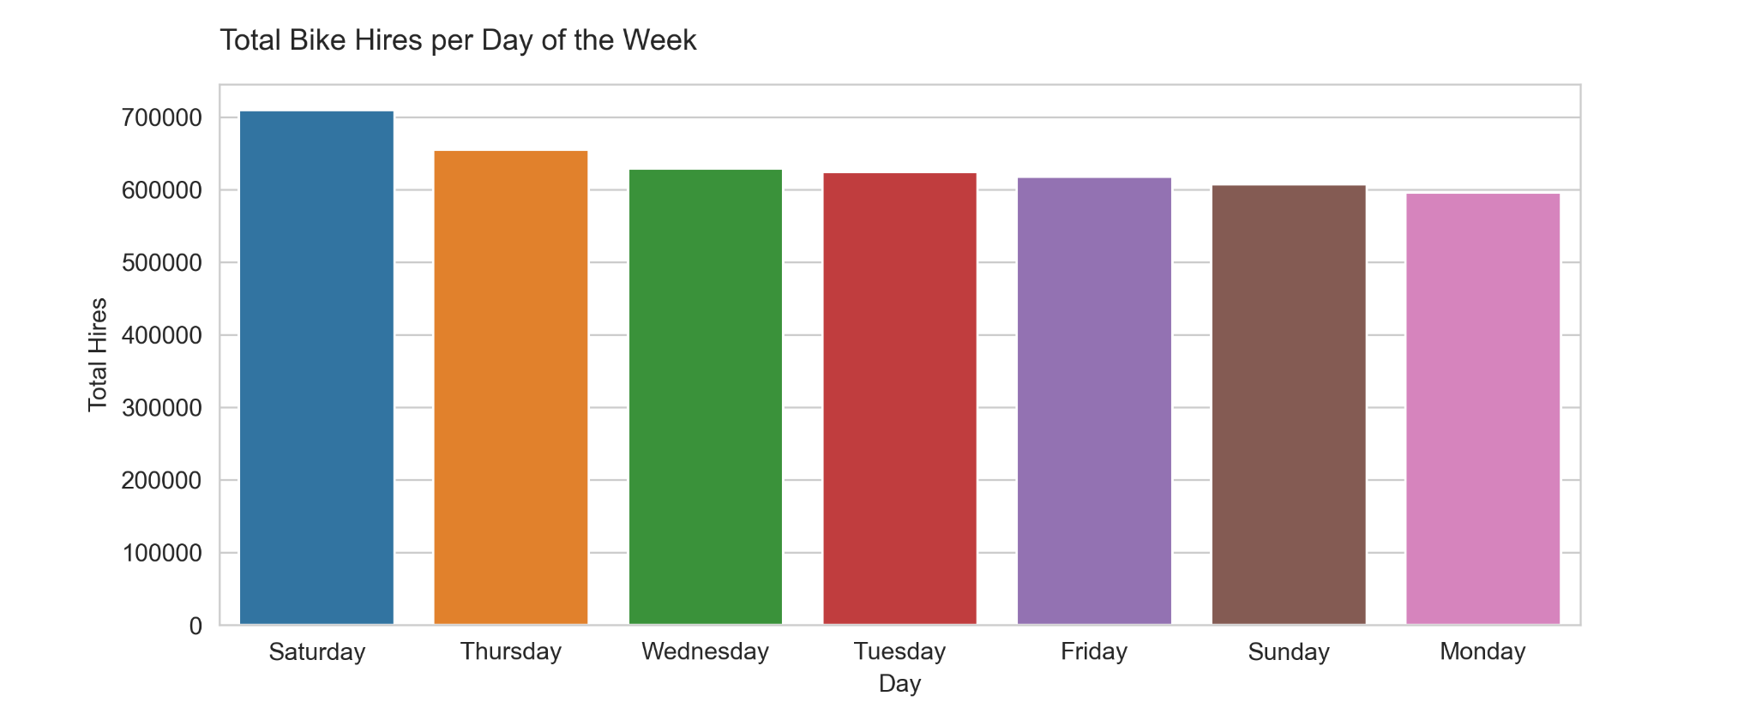
Weekend Wheels
Cyclist riders hire the most bikes on Saturday

Slide 8
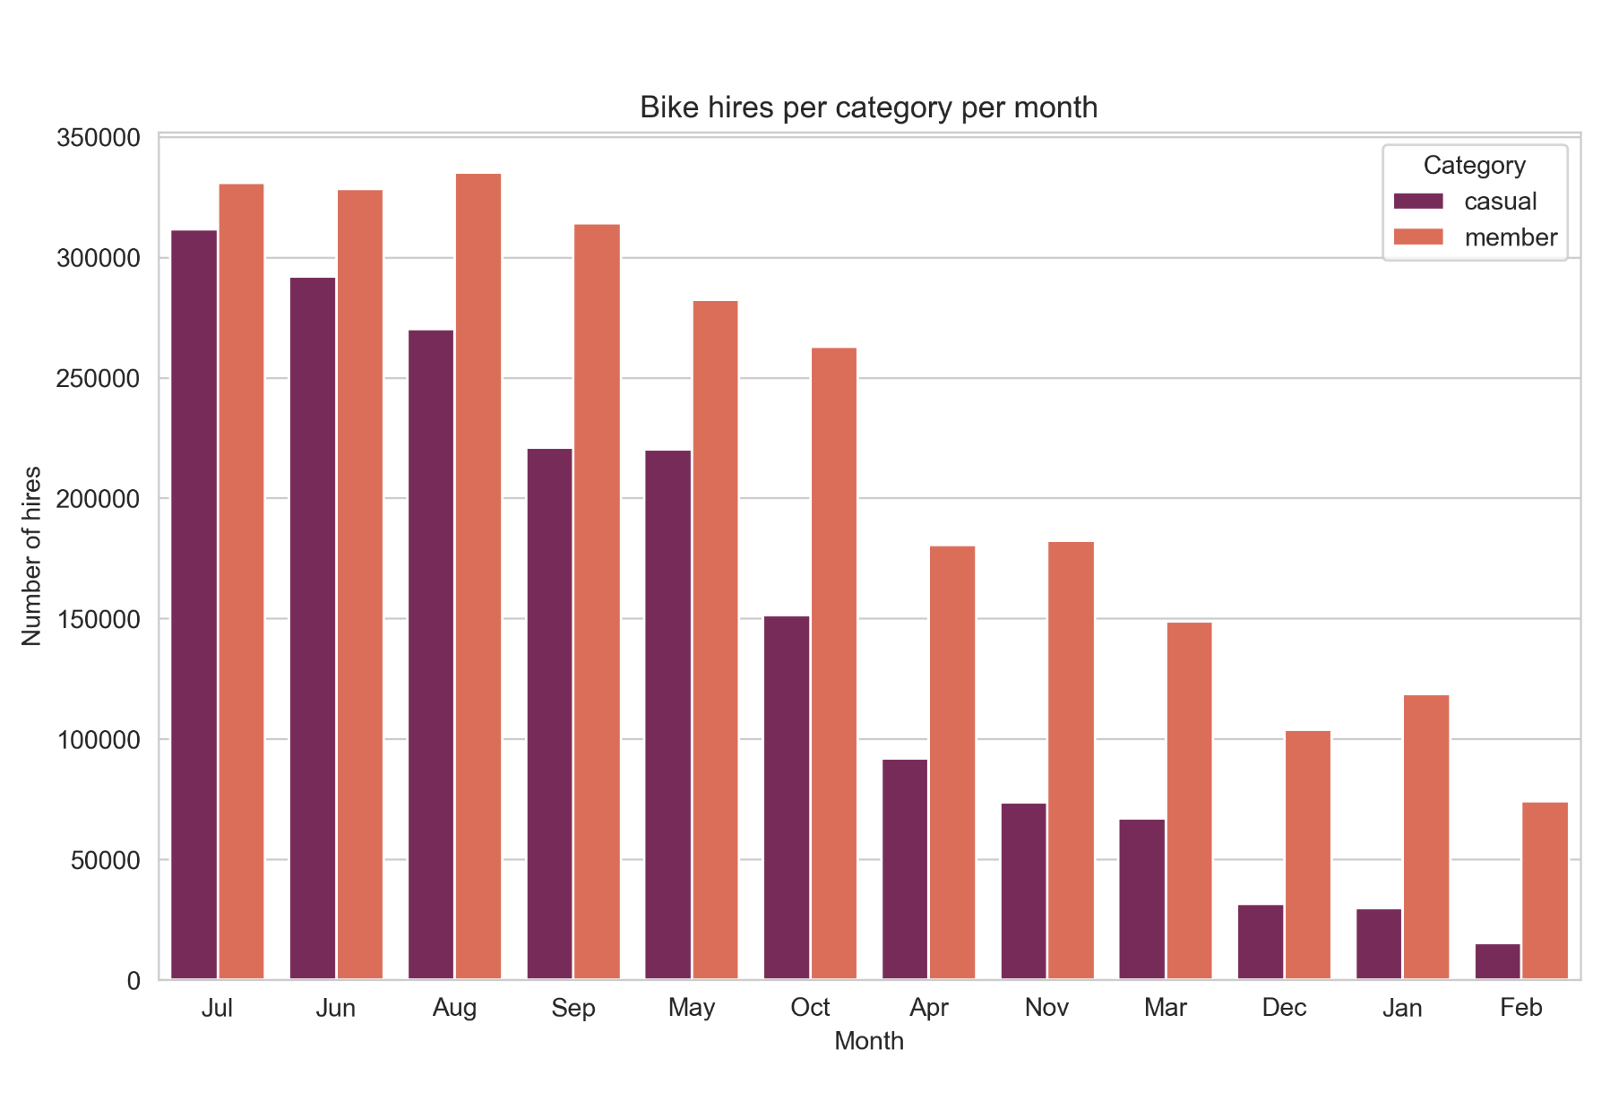
Huge difference in Winters
Riders hire fewer bikes in winter months but the difference between member hires and casual hires is larger

Slide 9
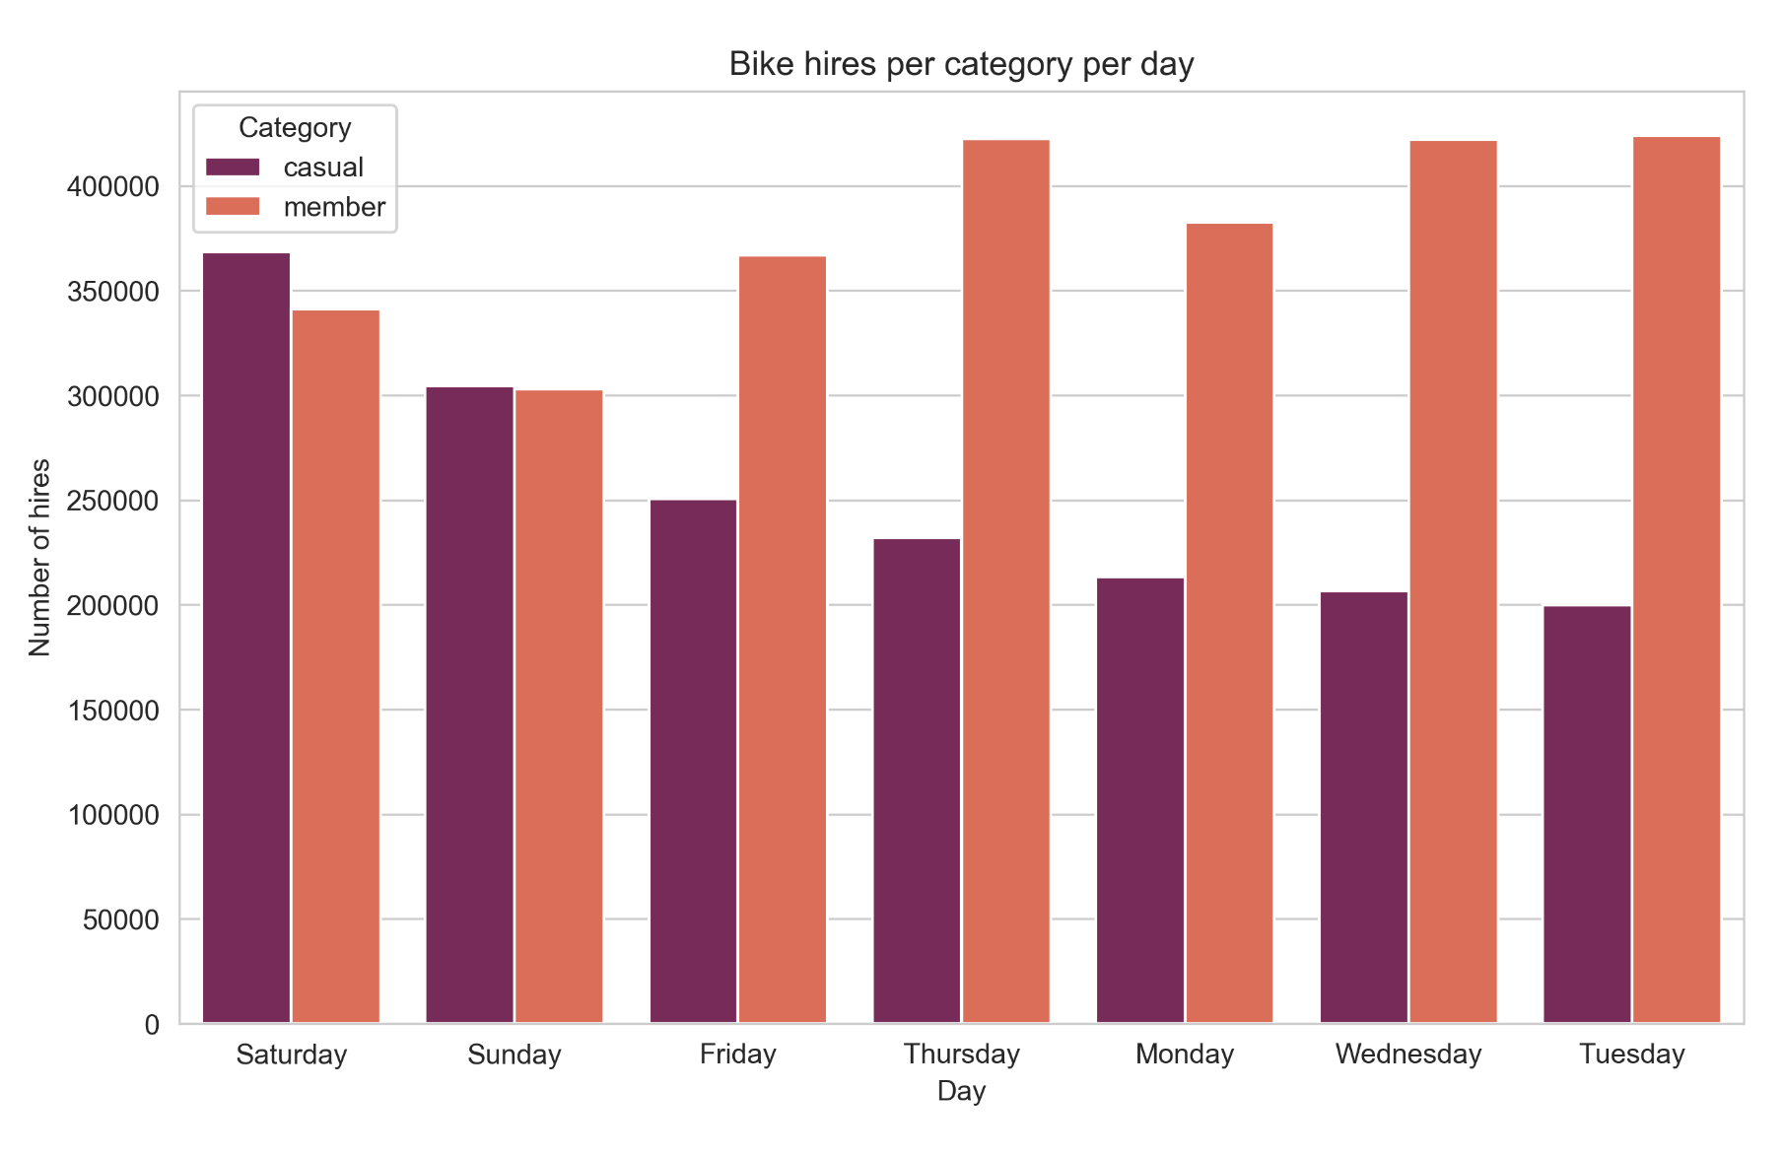
Daily Comparison
Casual riders hire more bikes than members on weekends
Members show consistenly hire bikes throughout the week
Notes:
Why do casual riders hire more on weekends? Fun weekend activity?
Why are members consistently hiring bikes? Work/school commute?

Slide 10
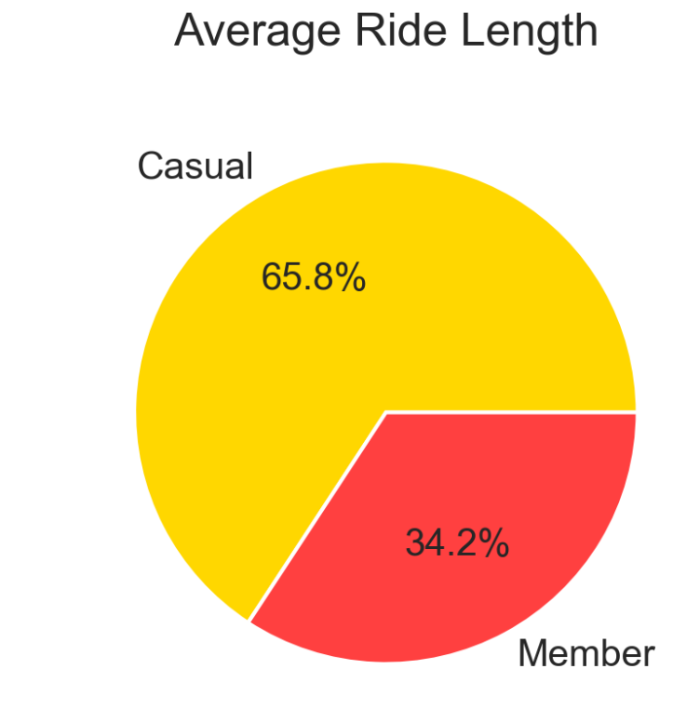
Ride Duration
Casual riders spend around 31% more time on their bikes than members
Notes:
Casual riders average ride length was 23.81 minutes
Member riders average ride length was 12.39 minutes

Slide 11
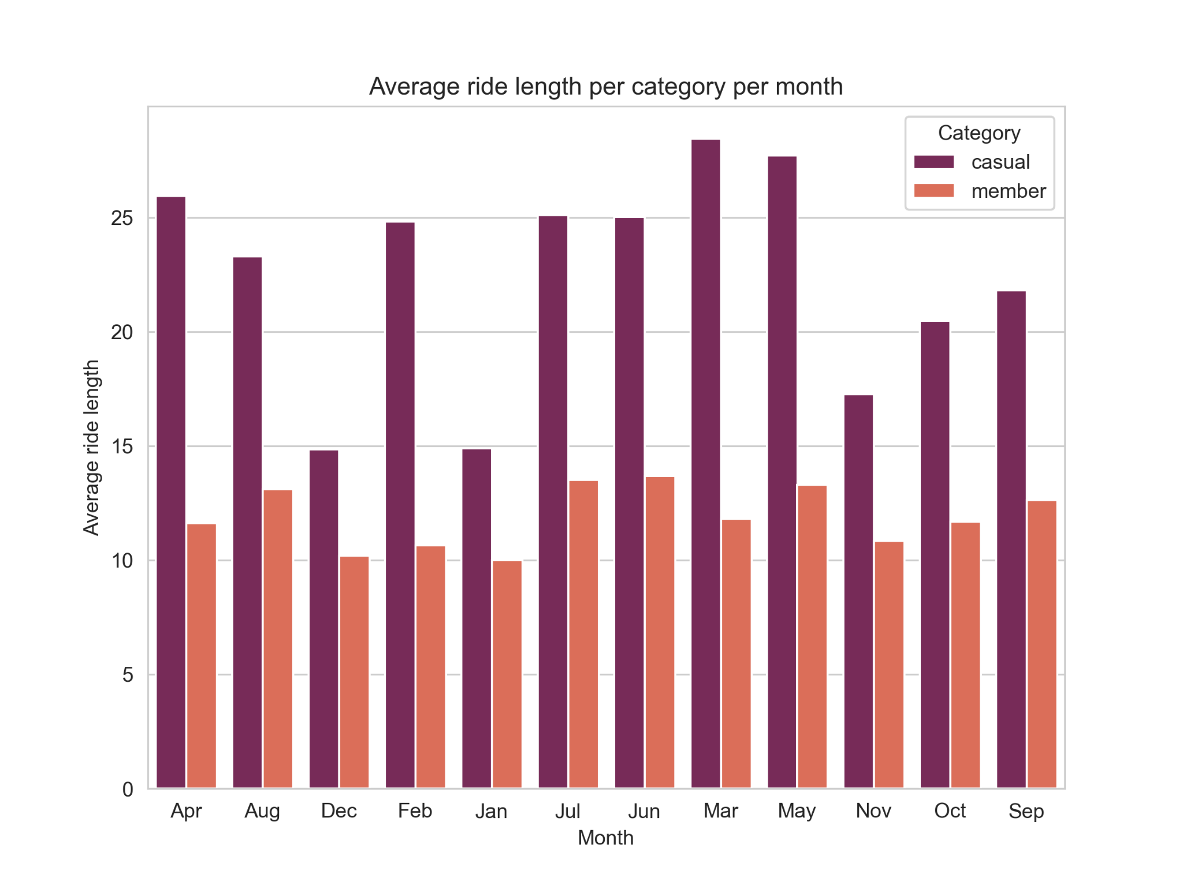
Average Duration: Monthly Comparison
Casual riders consistently outperform member riders throughout the year

Slide 12
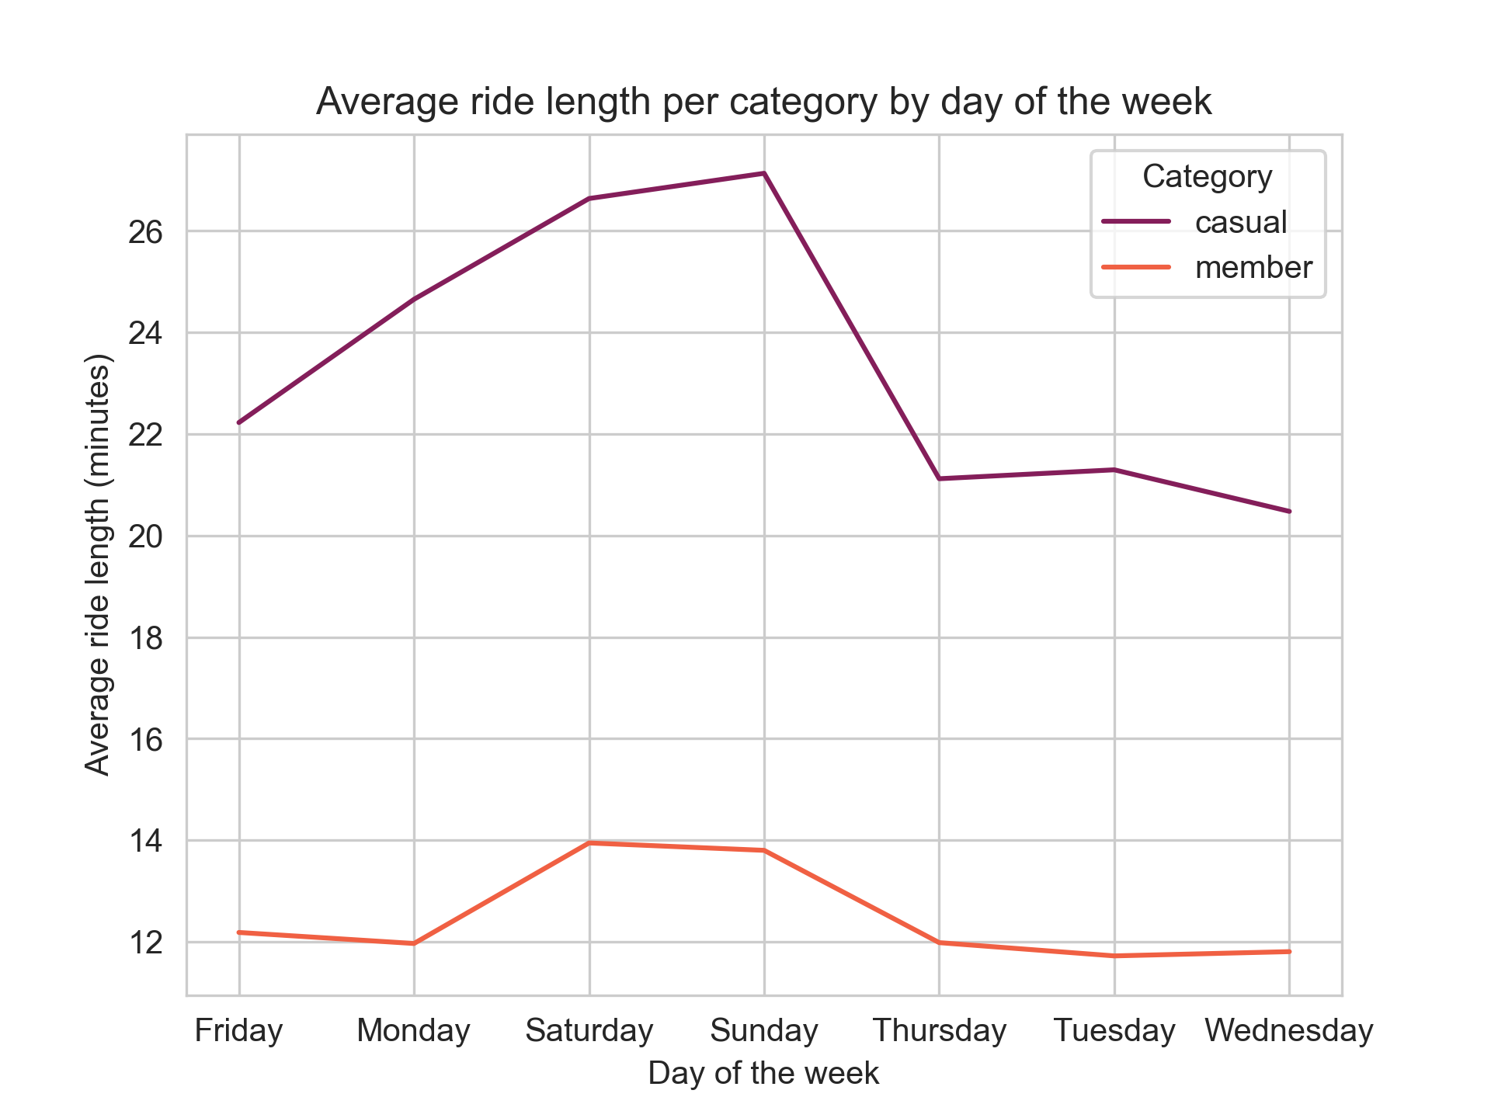
Average Duration: Daily Comparison
Casual riders consistently outperform member riders throughout the week as well

Slide 13
Summer months have the highest bike hires throughout the year
Summary
Weekends have the highest bike hires throughout the week
Casual riders ride longer than members

Slide 14

Recommendations
Launch a summer promotion that targets casual bike riders. Offer a discount on bike rentals for casual riders during the summer months. This could incentivize more casual riders to rent bikes
Create a weekend-specific promotion to encourage more weekend rentals. Offer a free rental day for every two days rented on a weekend.
Create a loyalty program that rewards frequent casual riders with discounts or other incentives. This could encourage more repeat business from this group and help build a loyal customer base.

Slide 15
THANK
YOU

